Slide 1

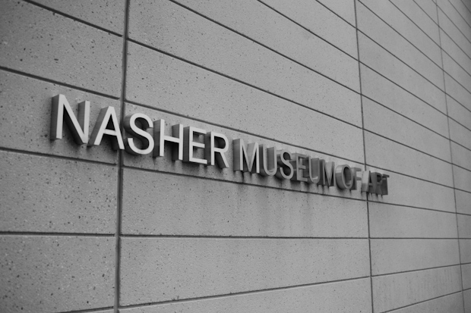
Coding the Collection:
Sprint 2 Demo
Team: Will Ye, Edward Zhuang, Sam Chan, Santo Grillo
Clients: Julia McHugh, Mark Olson

Slide 2
Demo
Sam: All Projects, Project, Create New Project, Home Pages
Santo: Presentation Page, Interactive/3D Modeling Pages
Eddie: Sign in, Registration Pages
Will: Upload, Update Pages

Slide 3
Value
Static Pages
Familiarize ourselves with React
Get UI feedback
Serves as foundation of application
Notes:
We decided to

Slide 4
User Testing Results
Positive Feedback
Design matches Nasher’s aesthetic well
Application is straightforward, easy to use for curators
Critical Feedback:
Want way to provide more than one piece of contextual media
Feasibility of collaboration among users is unclear
Notes:
We were able to meet with our clients last week and have them play through our wireframes and our static page development up until that point. From this meeting, we received a lot of great feedback.

Slide 5
Data
Little personal information
Login
Email, username
Password?
Exhibits and artwork
Names and descriptions
Photos and 3D models

Slide 6
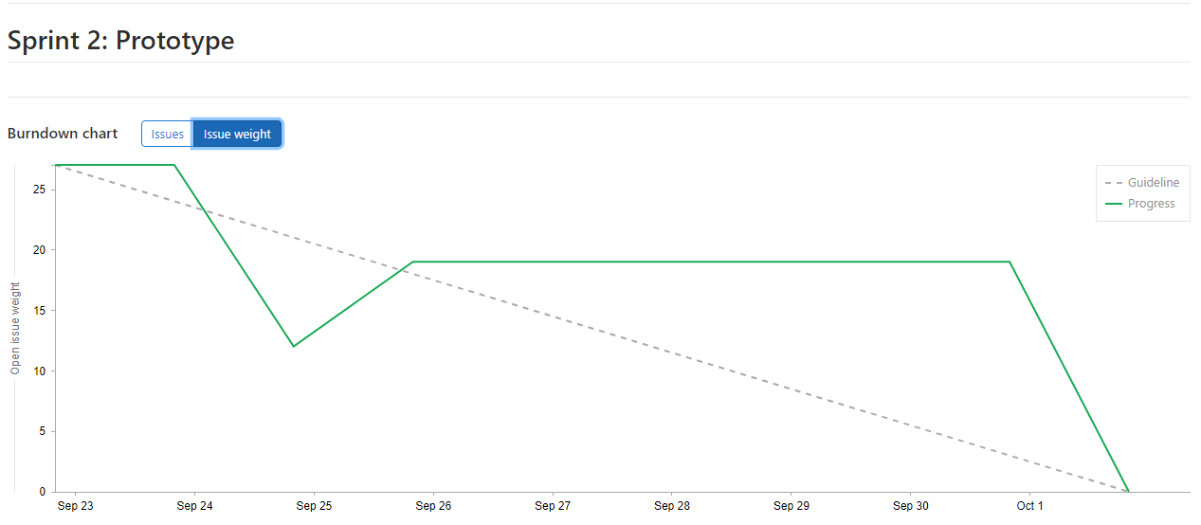
Burndown Chart

Slide 7
Timeline
Week 1
Setup basic app framework
Ensure everyone has functioning IDE
Gain Familiarity with React
Week 2
Meet with users to get feedback on the wireframe
Build static web implementations of wireframe pages

Slide 8
Retrospective
What worked
Dividing and completing work
What did not work:
Time estimates, meeting attendance

Slide 9
Planning Next Sprint
Key Tasks:
Stand up Firebase Backend
Set up Authentication (Google / Shibboleth)
Hook up database to the front end pages
Looking Ahead: 3D Model Implementation!

Slide 10
Thanks for Listening!

